Slide 1
Practical Data Compression
Lewis Wilson (1413099/ma14ljw)
Department of Mathematics, College of Engineering,
Design and Physical Sciences
2018

Slide 2
What is Data Compression?
Data is stored as a series of bits (computer storage units – 0 or 1 values);
Compression is to store data using fewer bits;
Two types of compression:
Lossless – Data is stored in it’s entirety;
Lossy – ‘Unnecessary’ artefacts are removed;
Applications: video/audio streaming, compacting business data…
Focus: Lossless Compression

Slide 3













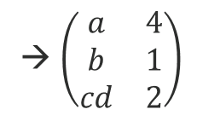
Huffman Coding
Symbol | a | b | c | d
Code (e.g.) | 00000001 | 00000010 | 00000011 | 00000111
Unencoded Data: aaaabcd
(size: 7 x 8 bits = 56 bits)
Assuming each symbol is represented using 8 bits
1.
Symbol Concatenation
2.
Huffman Tree Creation
$$\left(\begin{matrix}a & 4 \\ b & 1 \\ c & 1 \\ d & 1\end{matrix}\right)$$
$$\begin{matrix}abcd\end{matrix}$$
→ $\left(\begin{matrix}a & 4 \\ b & 1 \\ cd & 2\end{matrix}\right)$
$\left(\begin{matrix}abcd\end{matrix}\right)$ → $\left(\begin{matrix}a \\ bcd\end{matrix}\right)$
→ $\left(\begin{matrix}a & 4 \\ bcd & 3\end{matrix}\right)$
→ $\left(\begin{matrix}abcd & 7\end{matrix}\right)$
0
1
$$\begin{matrix}a\end{matrix}$$
$$bcd$$
3.
Code Generation
$\left(\begin{matrix}a \\ bcd\end{matrix}\right)$ → $\left(\begin{matrix}a \\ b \\ cd\end{matrix}\right)$
0
1
Symbol | a | b | c | d
Code | 0 | 10 | 110 | 111
$$b$$
$$cd$$
$\left(\begin{matrix}a \\ b \\ cd\end{matrix}\right)$ → $\left(\begin{matrix}a \\ b \\ c \\ d\end{matrix}\right)$
1
0
Encoded Data: 000010110111
Size: (4x1)+(1x2)+(1x3)+(1x3) = 12 bits
Efficiency: (12 ÷ 56) x 100 ≈ 21.4%
$$c$$
$$d$$

Slide 4
Lempel-Ziv-77 (LZ77)
The ‘Sliding Window’
Search Buffer
Look-Ahead Window
← Processed Data
Data to be Processed →
Separator
The “Sliding Window” method;
Tries to match data in the look-ahead window, with data in the search buffer;
Stores the original dataset as a collection of tokens;
Example data: abcaebbbcabedeeeeee
abcaebbbc | abedeeeeee
abcaebbbc | abedeeeeee
abcaebbbcabe | deeeeee
1. Find first LA-window symbol match
3. Try to match the next symbol
5. Slide the “window” along
abcaebbbc | abedeeeeee
<offset, match length, next symbol>
6. Repeat the process…
2. Try to match the next symbol
4. Create a token

Slide 5
Lempel-Ziv-4 (LZ4)
LZ4 Data Block Format
1 byte | 0-n bytes | 0-L bytes | 2 bytes | 0-n bytes
Token | Symbol Length+ | Symbols | Offset | Match Length+
Variant of LZ77 - data stored as “blocks”;
Upper token field – frequency of symbols, lower token field – length of match;
Offset – number of positions to traverse towards the beginning of the data;
Unencoded Data: aaabcaabc (size: 9 x 8 bits = 72 bits)
|aaabcaabc
aaabc|aabc
1. For the first symbol, check for a match ≥ 4 in length
3. Repeat until a match ≥ 4 is found
5. Repeat the process…
a|aabcaabc
54aaabc0400
Size of block: (1 x 8 bits) + (5 x 8 bits) + (2 x 8 bits) = 64 bits
Efficiency: (64 ÷ 72) x 100 ≈ 88.9%
2. For the 2nd symbol, check for a match ≥ 4 in length
4. Create a data block

Slide 6
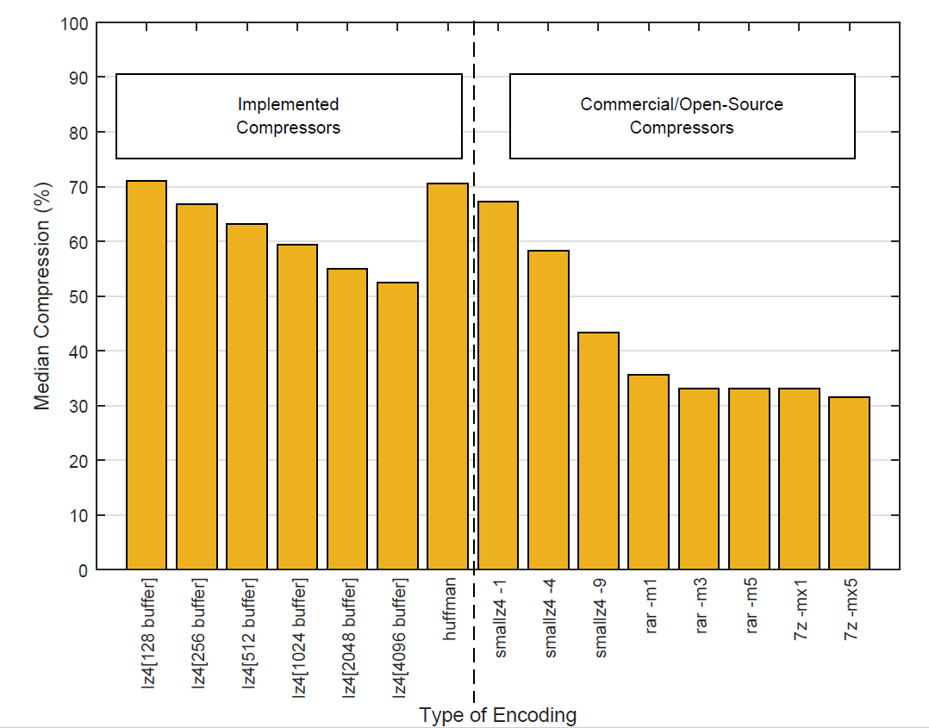
Implementations
Encoder Compression Rates
Produced:
Huffman Encoder/Decoder;
LZ4 Encoder/Decoder;
Compared against commercial compressors:
smalLZ4;
WinRAR;
7-Zip
Achieved 52.4% compression
SmalLZ4 is optimal LZ4 compression

Slide 7
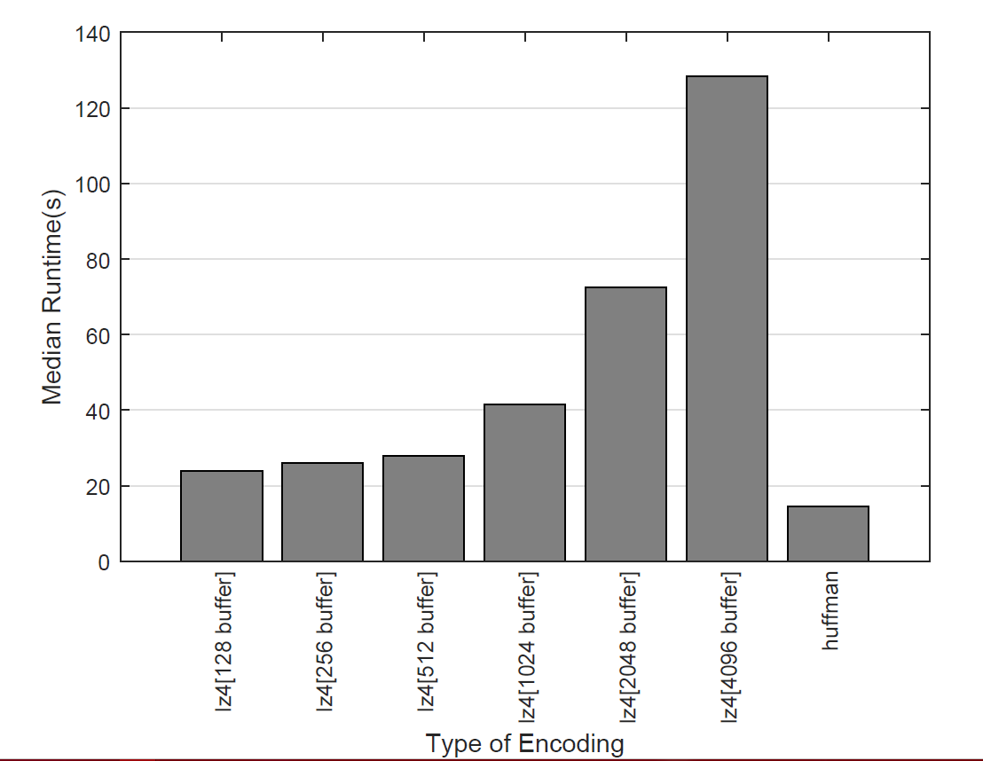
The Next Step
Compression rates are good;
Runtimes could be improved…
Huffman performed best (14.4s);
For LZ4 – better compression, results in extended runtimes;
OS/Commercial Compressors <1s
Encoder Runtimes

Slide 8
Any Questions?

Slide 9
Prefix Codes
Fixed-Length Codes (e.g. a=0001, b=0010, c=0011)
Variable-Length Codes (e.g. a=1, b=10, c=111) – can be prefix (free) codes
Encoded Data: 10011010
Codes with Prefixes
Prefix Codes
Symbol | a | b | c | d
Code | 0 | 10 | 11 | 100
Symbol | a | b | c | d
Code | 0 | 10 | 110 | 111
b: 10, is a prefix of d: 100
No codes are prefixes of one another
Decoded_1: bacab
Decoded_2: dcab
Decoded: bacb

Slide 10
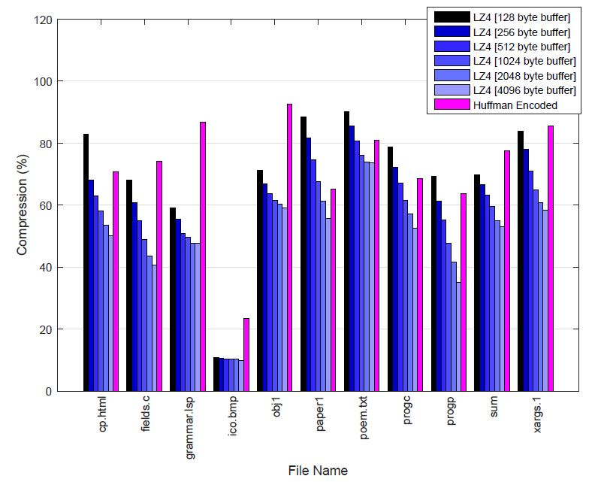
Per-File Compression Breakdown

